Slide 1
Case5: Hertz car rental – Segmentation & Poisson Negbin
Yu-Min Wang
Fall 2017
MKT 6v99

Slide 2
agenda
Executive Summary
Biz Objective
Segmentation
Top Down KPI & Strategy for Each Cluster
Elasticity & Test Plan
Financial Implication
Poisson Negbin – Variables & Forecast for Each Cluster
Conclusion

Slide 3
Executive summary
The 7014 customers are segmented into 5 clusters by using LatentGold
The price elasticity is calculated for each cluster regarding GROSS as revenue and NUM_DAYS as quantity
Each cluster is inelastic in price
Recommendation is to raise price/day for each cluster
The total revenue is expected to increase by 33%
Applying Poisson for each cluster, a forecast model of NUM_DAYS for each cluster is come out along with significant independent variables

Slide 4
Biz Objective
1
Segment Hertz’s customers and calculate elasticity
for each cluster
2
Find out the forecast model of NUM_DAYS for each
cluster of Hertz’s customers

Slide 5
five Segments
Clus1 :
Silver
The largest cluster with the highest household_income. Following Golden, it is #2 in each index of sales contribution
Clus2 :
Elder
The oldest, the 2nd largest, and the 2nd richest cluster. They seemed not active in Hertz because the AVG rental gap month is 11, not far away from Churned
Clus3 : Churned
This cluster has churned away from Hertz. 897 days since last rental, 13 AVG rental gap months. The 2nd lowest in NUM_RNTL and NUM_DAYS
Clus4 : Golden
This is Hertz’s loyal and core customer. With only 12.4% of customers, this cluster contributes 44.4% of revenue. Ranked #1 in all indexes of engagement, although they are not the richest.
Clus5 : NewComer
They are the newest to Hertz. Brand tenure only 150, they are the least in NUM_RNTLS and NUM_DAYS. They contributed almost 0 to revenue.

Slide 6
% Customers v. % Revenue & NUM_DAYS
Golden & Silver clusters contribute 73% of revenue with only 46% of customers
Retaining Golden, targeting Silver, while understanding the cause of low engagement in the other clusters

Slide 7
Top down kpi and strategy
 | Silver | Elder | Churned | Golden | NewComer
% Customers | 33.6% | 30.5% | 19.8% | 12.4% | 3.8%
% Revenue | 28.8% | 18.5% | 8.0% | 44.4% | 0.3%
BRAND_TENURE | 2543 | 2174 | 1491 | 2713 | 150
AVG_RENTAL_GAP_MTHS | 7 | 11 | 13 | 1 | 2
DAYS_SINCE_LAST_RENTAL | 69 | 380 | 897 | 73 | 675
GROSS | 4203 | 2965 | 1974 | 17549 | 444
NUM_RNTLS | 26 | 18 | 11 | 123 | 2
NUM_DAYS | 89 | 65 | 44 | 405 | 11
NUM_CHNL_HERTZDOTCOM_RNTLS | 10 | 7 | 4 | 50 | 1
Num_Adults_in_LU | 2.87 | 2.86 | 2.86 | 2.82 | 2.74
household_income | 141952 | 135147 | 128257 | 133975 | 115910
AGE | 52.7 | 53.9 | 53.4 | 50.8 | 52.2
TOTAL_NET_SENT | 55.1 | 53.7 | 45.4 | 62.9 | 42.4
TOTAL_OPENS | 15.7 | 13.2 | 9.6 | 20.3 | 8.4
TOTAL_CLICKS | 1.2 | 0.7 | 0.3 | 2.0 | 0.4
Silver - put more resource on this cluster because they have the most potential to grow. Send more campaigns, DM,… to drive more revenue.
Elder – their low engagement is because of their age, not necessary because they dislike us. Customize our campaign, DM, and service for elders.
Churned – they really have gone away. Survey their reason of churn for our reference.
Golden – design some campaigns for these loyal customers to refer Hertz to their friends.
NewComer – keep contact to let this cluster know more about Hertz and rent more.

Slide 8
Elasticity & Test plan
With GROSS (revenue) and NUM_DAYS we can get the unit price (price/day)
Do OLS for NUM_DAYS on each cluster to get the coefficient of price
With avgPrice and avgQty, we can get Elasticity for each cluster
We found each cluster is inelastic, the recommendation is to raise the net price, or decrease discount
Suggestion about
Price/day
up 50%
up 50%
up 50%
up 40%
up 60%
Test plan
20% @ 30days
40% @ 30days
20% @ 30days
40% @ 30days
20% @ 30days
40% @ 30days
10% @ 30days
30% @ 30days
20% @ 30days
40% @ 30days

Slide 9
Financial Implication
Hertz’s total revenue will increase 33%, from current $34,329,886 to $45,549,384

Slide 10
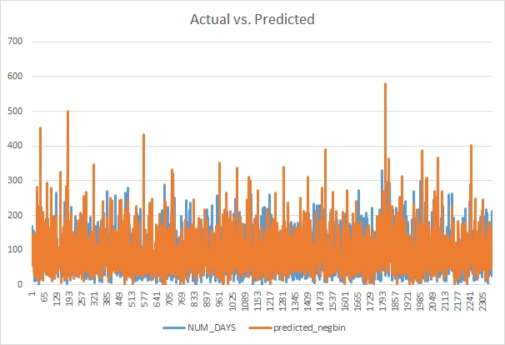
Clus1 (Silver) Poisson NegBin NUM_DAYS Forecast
Parameter | Estimate | Pr > |t|
Intercept | 3.946528 | <.0001
BRAND_TENURE | 5.5522E-05 | 0.0217
NUM_BUS_RNTLS | 0.013043 | <.0001
NUM_LEI_RNTLS | 0.043057 | <.0001
AVG_RENTAL_GAP_MTHS | -0.032756 | <.0001
TOTAL_NET_SENT | 0.000717 | 0.0005
management_occ | -0.052434 | 0.0075
professinal_occ | -0.071787 | 0.0029
sales_occ | -0.1229 | 0.0004
bluecollar_occ | -0.077207 | 0.0267
EDUC_YEARS | -0.014491 | <.0001
_Alpha | 0.13548 | <.0001

Slide 11
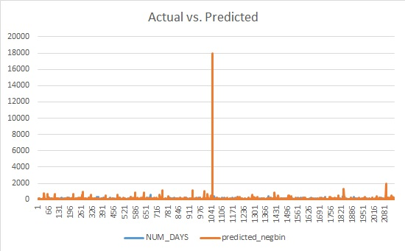
Clus2 (elder) Poisson NegBin NUM_DAYS Forecast
Parameter | Estimate | Pr > |t|
Intercept | 3.436146 | <.0001
BRAND_TENURE | 0.000122 | <.0001
NUM_BUS_RNTLS | 0.017462 | <.0001
NUM_LEI_RNTLS | 0.063773 | <.0001
AVG_RENTAL_GAP_MTHS | -0.0221 | <.0001
TOTAL_NET_SENT | 0.000495 | 0.0344
management_occ | -0.073856 | 0.0012
professinal_occ | -0.068072 | 0.0158
sales_occ | -0.115409 | 0.004
bluecollar_occ | -0.084405 | 0.0505
EDUC_YEARS | -0.011928 | 0.0056
_Alpha | 0.164861 | <.0001

Slide 12
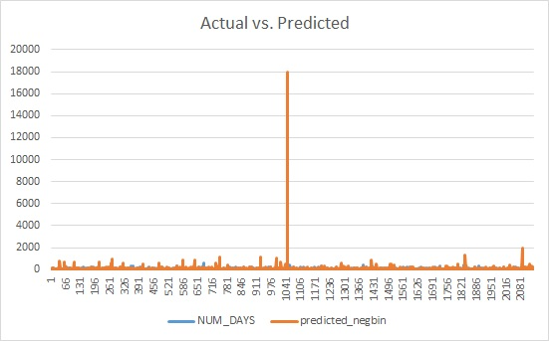
Clus3 (churned) Poisson NegBin NUM_DAYS Forecast
Parameter | Estimate | Pr > |t|
Intercept | 2.990498 | <.0001
BRAND_TENURE | 0.000133 | <.0001
NUM_BUS_RNTLS | 0.020187 | <.0001
NUM_LEI_RNTLS | 0.092582 | <.0001
AVG_RENTAL_GAP_MTHS | -0.023818 | <.0001
_Alpha | 0.197362 | <.0001

Slide 13
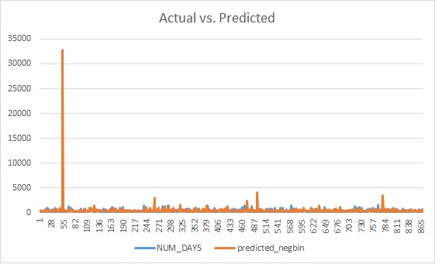
Clus4 (golden) Poisson NegBin NUM_DAYS Forecast
Parameter | Estimate | Pr > |t|
Intercept | 6.2502 | <.0001
BRAND_TENURE | -0.000234 | <.0001
NUM_BUS_RNTLS | 0.003004 | <.0001
NUM_LEI_RNTLS | 0.009994 | <.0001
management_occ | -0.053375 | 0.0377
sales_occ | -0.131982 | 0.0105
bluecollar_occ | -0.12292 | 0.0115
EDUC_YEARS | -0.017458 | 0.0008
_Alpha | 0.118264 | <.0001

Slide 14
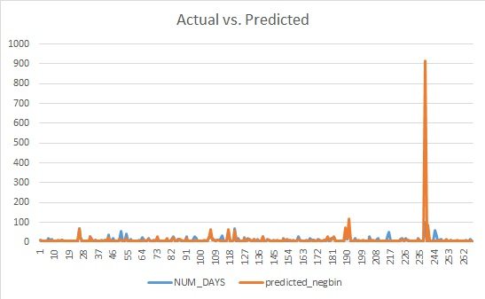
Clus5 (newcomer) Poisson NegBin NUM_DAYS Forecast
Parameter | Estimate | Pr > |t|
Intercept | 1.523793 | <.0001
NUM_BUS_RNTLS | 0.051579 | 0.0039
NUM_LEI_RNTLS | 0.441351 | <.0001
_Alpha | 0.40781 | <.0001

Slide 15
Conclusion
5 clusters
Silver
Elder
Churned
Golden
NewComer
Price inelastic in each cluster
Suggest to raise net price through test plan
Expected to increase 33% in total revenue
Poisson NegBin to come out the forecast model of NUM_DAYS for each cluster

